Slide 1
MRM Performance Metrics –
The EQE Framework
“Metric” – a system or standard of measurement
“EQE Metrics” - efficiency, quality & effectiveness metrics applied to resources, processes, services and programs defined in the MRM
  Efficiency metric is a cost per unit of value
  Quality metric is a comparison to a standard
  Effectiveness metric is a contribution to a metric at the next level ‘up’ in the MRM ‘stack’
© Chartwell Inc. 1998

Slide 2
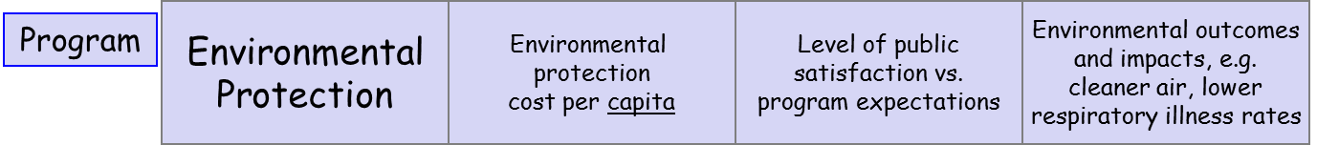



EQE Illustration
Efficiency
Output Value
Input Cost
Quality
Comparison
to Standards
Effectiveness
Contribution
to Next Level
Example
Metrics
© Chartwell Inc. 1998

Slide 3
Higher Level Outcomes
Use the MRM to analyze performance indicator linkages
Program
Outcomes
Service
Effectiveness
Measures
Process
Effectiveness
Measures
Resource
Effectiveness
Measures
Service
Standards
Practice
Standards
Resource
Standards
Program
Quality
Measures
Service
Quality
Measures
Process
Quality
Measures
Resource
Quality
Measures
Program
Efficiency
Measures
Service
Efficiency
Measures
Process
Efficiency
Measures
Resource
Efficiency
Measures
© Chartwell Inc. 1998

